Slide 1


SPECIFICATIONS

Slide 2
Rom Specification
Runs on 80 kbytes
20 kwords (20480 x 32 bits)
Contains:
Bootstrap code
Not patchable
802.15.4 MAC and drivers
Mac software builds on lower level hardware capability of the transceiver and MACA.

Slide 3
Ram Specification
Runs on a 96 kbytes application SRAM
Ram is broken into 4 pages:
Ram0: 8 kbytes, 2 kwords (8192 bytes)
Ram1: 24 kbytes, 6 kwords (24576 bytes)
Ram2: 32 kbytes, 8 kwords (32768 bytes)
Ram3: 32 kbytes, 8 kwords (32768 bytes)
Read and write is a minimum of two system clock cycles
Stall signal generated for read after writing cycle

Slide 4
Ram Specification cont….
Ram power down options features:
RAM0: Always powered on under a sleep condition
RAM1-RAM3: Always powered on or powered off during sleep mode with respect to the combination of 8, 32, 64 96 kbytes active.
Ram remainder after sleep mode continues low voltage mode for data retention.
Ram is loaded from the serial FLASH at boot time and must be re-loaded every time after waking up from sleep mode.
Boot time varies depending on how many pages are powered down due to load dependency with FLASH

Slide 5
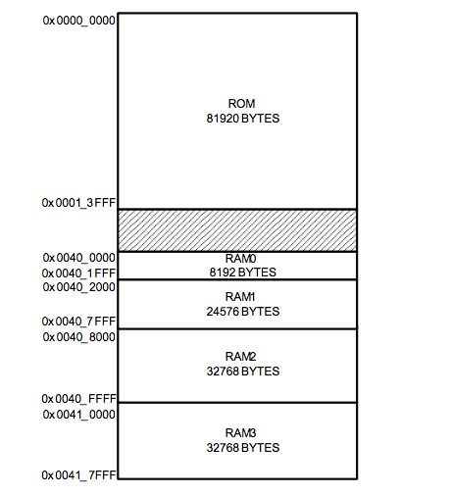
Ram Specification cont….
Address Recovery after wake-up
Execution starts at address 0x0040_0000
Recovery routine for reloading powered- down SRAM must take place in RAM0

Slide 6
Rom Advantages & Disadvantages
Advantages:
ROM does not require a constant source of power to retain information stored in it.
Instructions saved on to chip after powered down
Disadvantages:
Writing data to a ROM chip is a slow process
ROM chip usually store megabytes of data (Average: 4mb to 8mb)

Slide 7
Ram Advantages & Disadvantages
Advantages:
Writing data to the RAM is a much faster process than ROM
Ram chip can store multiple gigabytes of data. (Average: 1gb to 256gb per chip)
Disadvantages:
Information stored in the RAM chip will be lost if loses power

